Slide 1

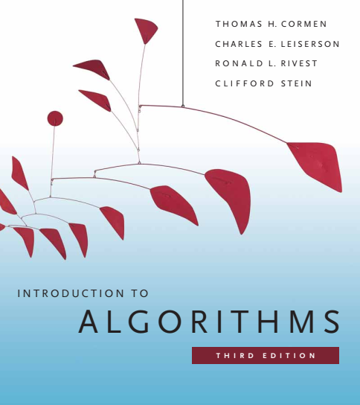
Design and Analysis of Algorithms
Dr. Sajid Iqbal
sajidiqbal.pk@gmail.com
Reference Book
Introduction to Algorithms 3rd Edition By Thomas H. Cormen et. al.
https://mitpress.mit.edu/books/introduction-algorithms-third-edition
COMEDXD

Slide 2
Radix Sort
A Non-Comparison sort

Slide 3
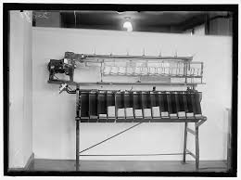
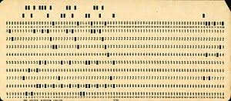
Introduction
Cards Sorting machines have been using this algorithm to sort cards
A card to be sorted has 80 columns and the machine has to punch a hole in one of 12 places
The sorter then examines a given column of card places it in one of 12 bins
Card punched in first column have higher value then 2nd column hole cards and so on
For decimal digits, only 10 hole places are used
Rest two places are used to encode non-numeric characters
A d-digit number would then occupy a field of d columns.
Card sorter can look at one column at a time, a sorting algorithm is required to sort the cards
IBM 80-column punched card format
You can read more about punch cards at
https://en.wikipedia.org/wiki/Punched_card

Slide 4
Introduction
The sorting approach
Sort numbers on their most significant digit
Sort each of the resulting bins recursively
combine the decks in order.
This process creates many intermediate bins
Radix sort solves by sorting on the least significant digit first.
The algorithm then combines the cards into a single deck, with the cards in the 0 bin preceding the cards in the 1 bin preceding the cards in the 2 bin, and so on.
Then it sorts the entire deck again on the second-least significant digit and recombines the deck in a like manner.
The process continues until the cards have been sorted on all d digits.
Only d passes through the deck are required to sort.

Slide 5
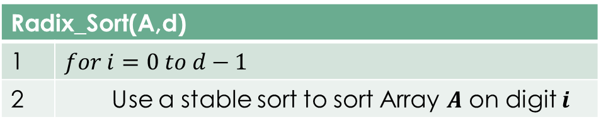
Radix Sorting
We may use this approach to sort the data which is indexed by multiple-keys
For example dates in computer can be first sorted using years then months and then days
If A is an array and d is the number of digits in that array then
3 | 2 | 9
4 | 5 | 7
6 | 5 | 7
8 | 3 | 9
4 | 3 | 6
7 | 2 | 0
3 | 5 | 5
7 | 2 | 0
3 | 5 | 5
4 | 3 | 6
4 | 5 | 7
6 | 5 | 7
3 | 2 | 9
8 | 3 | 9
7 | 2 | 0
3 | 2 | 9
4 | 3 | 6
8 | 3 | 9
3 | 5 | 5
4 | 5 | 7
6 | 5 | 7
3 | 2 | 9
3 | 5 | 5
4 | 3 | 6
4 | 5 | 7
6 | 5 | 7
7 | 2 | 0
8 | 3 | 9
Radix_Sort(A,d)
1 | $$for i=0 to d−1$$
2 | Use a stable sort to sort Array $A$ on digit $i$

Slide 6

Lemma 8.3
Statement:
For a $n$ $d$-digit numbers where each digit has range $0−k$ ($k$ possibilities). Radix sort can sort these numbers in $θ\left(d\left(n+k\right)\right)$ time if the stable sort used takes $θ\left(n+k\right)$ time.
Proof:
If each digit has $k$-possible values and k is not too large. Counting sort is obvious choice.
Each pass over $n d$-digit numbers takes $θ\left(n+k\right)$ time
There are $d$ passes so the total time for radix sort is $θ(d\left(n+k\right))$

Slide 7
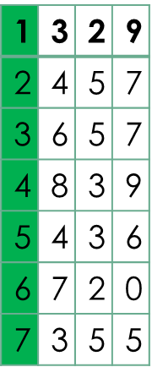


Lemma 8.4
Statement:
For n b-bit numbers and any positive integer $r≤b$. Radix Sort sorts these numbers in $θ(\frac{b}{r}\left(n+2^{r}\right))$ time if the stable sort takes $θ(n+k)$ time for the inputs in the range 0-k.
Proof:
For a value $r<b$, each key has $d=b/r$ digits of $r$ bits each
Each digit is an integer in the range $0 to 2^{r}−1$. We can use counting sort with $k=2^{r}−1$
Each pass of counting sort takes time $θ\left(n+k\right)=θ\left(n+2^{r}\right)$ and there are $d$ passes
So total running time is $θ\left[d\left(n+2^{r}\right)\right]=θ[\frac{b}{r}\left(n+2^{r}\right)]$
Let a $32$-bit quantity has $4 8$-bit digits.
$b=32,$
$r=8,$
$k=2^{r}−1=255$
$d=b/r=4$

Slide 8

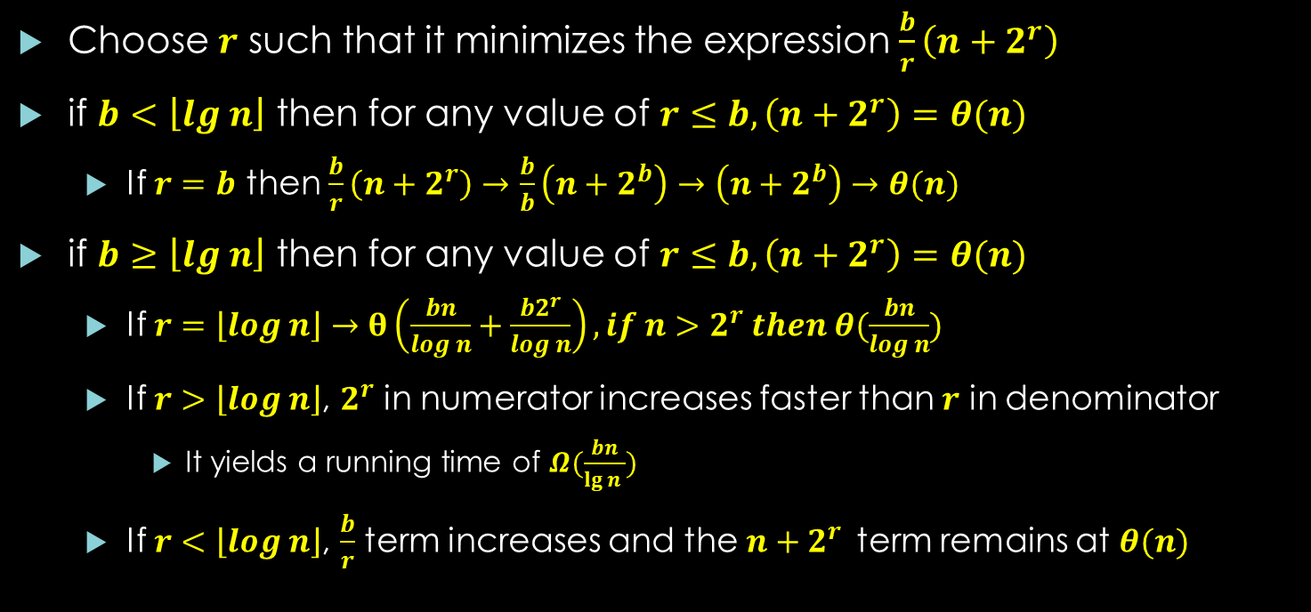
Time Complexity of Radix Sort
Choose $r$ such that it minimizes the expression $\frac{b}{r}\left(n+2^{r}\right)$
if $b<\left\lfloor lg n\right\rfloor$ then for any value of $r≤b, \left(n+2^{r}\right)=θ(n)$
If $r=b$ then $\frac{b}{r}\left(n+2^{r}\right)→$ $\frac{b}{b}\left(n+2^{b}\right)→\left(n+2^{b}\right)→θ(n)$
if $b≥\left\lfloor lg n\right\rfloor$ then for any value of $r≤b, \left(n+2^{r}\right)=θ(n)$
If $r=\left\lfloor log n\right\rfloor →θ\left(\frac{bn}{log n}+\frac{b2^{r}}{log n}\right), if n>2^{r} then θ(\frac{bn}{log n})$
If $r>\left\lfloor log n\right\rfloor$, $2^{r}$ in numerator increases faster than $r$ in denominator
It yields a running time of $Ω(\frac{bn}{\lg{n }})$
If $r<\left\lfloor log n\right\rfloor$, $\frac{b}{r}$ term increases and the $n+2^{r}$term remains at $θ(n)$
$n= number of keys$
$b = number of bits$
$$in each key$$
$d=number of digits in a key$
$r=bits in a digit$
$k=range of values$

Slide 9

Thanks for watching
Dr. Sajid Iqbal
Assistant Professor
Department of Computer Science
Bahauddin Zakariya University, Multan
sajidiqbal.pk@gmail.com
YouTube Channel: COMEDXD
Allah Hafiz

Slide 10
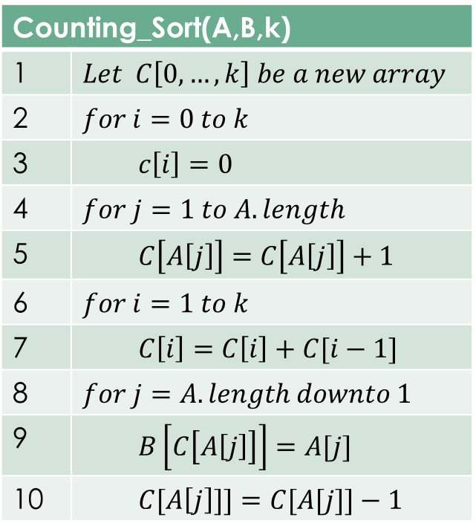
Counting_Sort(A,B,k)
1 | $$Let C\left[0,…,k\right] be a new array$$
2 | $$for i=0 to k$$
3 | $$c\left[i\right]=0$$
4 | $$for j=1 to A.length$$
5 | $$C\left[A\left[j\right]\right]=C\left[A\left[j\right]\right]+1$$
6 | $$for i=1 to k$$
7 | $$C\left[i\right]=C\left[i\right]+C[i−1]$$
8 | $$for j=A.length downto 1$$
9 | $$B\left[C\left[A\left[j\right]\right]\right]=A[j]$$
10 | $$C[A\left[j\right]]]=C[A[j]]−1$$

